Slide 1
The Rise of Democratic Ideas Greece

Slide 2
Legacy of Ancient Greece and Rome
For the most part, throughout history, people have lived under absolute rulers, such as chieftains, kings, or pharaohs, who have total power.
The idea that people can govern themselves- the idea of democracy, evolved very slowly over thousands of years
Ancient Greek civilization developed the first democracy

Slide 3
Democracy, “rule of the people”, comes from the Greek word demos, meaning “people,” and kratos, meaning “rule” or “authority.
Greek civilization began about 2000 B.C. in the form of city-states (because of mountainous terrain) which held 20,000 people each.

Slide 4
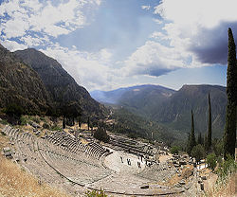

Slide 5
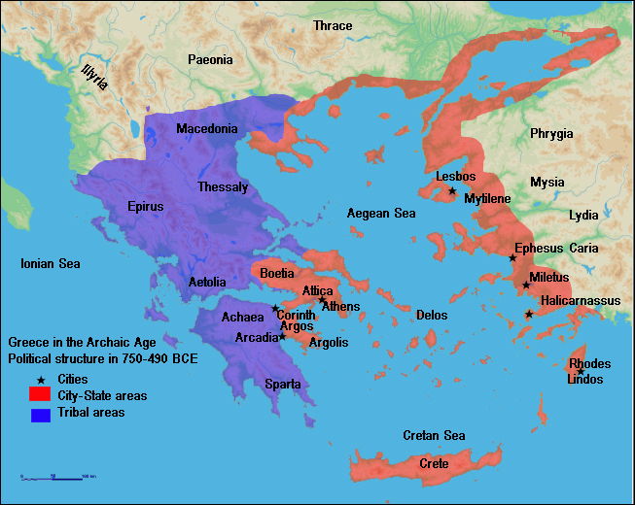

Slide 6
The Polis: Center of Greek Life
By 750 B.C., the polis, or city-state, had become the central focus of Greek life. The polis was the town, city, or village and its surrounding countryside. The people met for political, religious, social, and economic activities.
The main gathering place was usually on a hill, topped with a fortified area called the acropolis. This was a refuge and sometimes a place for religious or other public buildings. Below was the agora, an open area for people to assemble, often used as a marketplace.

Slide 7
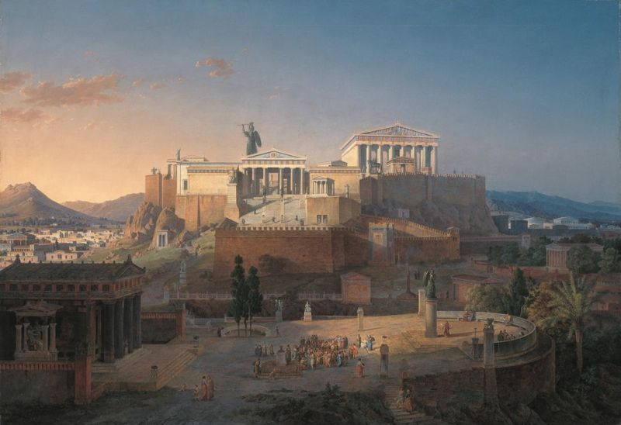
Acropolis in Athens

Slide 8
The Polis
City-states varied in size. Most were between a few hundred and several thousand people. Athens was one of the largest, with a population of more than three hundred thousand by 400 B.C.
The polis was a community of people who shared a common identity and common goals. There were three classes: citizens with political rights (adult males), citizens without political rights (women and children), and noncitizens (slaves and resident aliens).
Greek states developed different forms of government. Some city-states became democracies, ruled by many. Other became oligarchies, ruled by the few.

Slide 9
Athens
A king ruled early Athens. By the 7th century B.C. it was ruled by an oligarchy of aristocrats who owned the best land and controlled political life.
Near the end of the seventh century, economic problems led to political turmoil. Many Athenian farmers were sold into slavery for nonpayment of their debts to aristocrats. Cries arose to cancel the debts and give land to the poor. Civil war threatened.
The aristocrats gave power to Solon in 594 B.C. Solon favored reform. He canceled the debts but did not give land to the poor. This left the aristocrats in power and the poor unable to obtain land.

Slide 10
Solon also established four classes of citizenship based on wealth rather than heredity (Only the 3 highest classes could hold office)
Even the lowest class of citizens could vote in the assembly, and eventually, sit on juries
All free adult males were citizens

Slide 11
Solon also created a new council of Four Hundred- which prepared business for the already existing council
These acts increased participation in government, but Athens was still basically run by an aristocracy
Only about 1/10 were citizens
Citizenship was denied to women, slaves, and foreign residents

Slide 12
Athens
In 508 B.C., Cleisthenes, another reformer, gained the upper hand. He created a new Council of Five Hundred to supervise foreign affairs, oversee the treasury, and propose laws. He gave to the Athenian assembly, composed of male citizens, authority to pass laws after free and open debate.
He increased the power of the assembly by allowing all citizens to submit laws for debate and passage.
He wanted to break up the power of the nobility
For this reason, Cleisthenes’ reforms laid the foundation for Athenian democracy.

Slide 13
Classical Greece
Classical Greece is the name given to the period from 500 to 338 B.C. During this time, the Greeks fought two wars. The first war was against the Persians, who were defeated by the unified Greeks.
Athens took over the leadership of the Greek world after the Persian War. Under Pericles, the dominant figure in Athenian politics from 461 to 429 B.C., Athens expanded its empire, while democracy flourished at home.
Pericles created a direct democracy. Every male citizen could participate in the general assembly and vote on major issues. This period was called the Age of Pericles.
The Greek world was divided between the Athenian Empire and Sparta. Athens and Sparta had built very different societies and they distrusted each other. After a series of disputes, the second war of the Classical Greece period, the Great Peloponnesian War, broke out in 431 B.C.
Notes:
Pericles- Funeral Oration

Slide 14
Quiz
1. The word demos from democracy means?
2. By 750 B.C. the _________became the central focus of Greek life.
3. The _________ was a community of people who shared a common identity and goals.
4. __________ the type of government ruled by the few.
5. In Greece, citizenship was denied to which three groups?

Slide 15
Quiz
6. Pericles created a _________ __________where every male citizen could participate in the general assembly.
7. The Great Peloponnesian War (431 B.C.) was fought between what two city-states?
8. What contributions did Solon make to Greek society and politics?
9. What reforms did Cleisthenes make to the government?

Slide 16
Persian Wars
Thermopylae 480 Bc (History Channel) - YouTube

Slide 17
Classical Greece
The civil war lasted 27 years, until 405 B.C. Athens surrendered when the Athenian fleet was destroyed.
The Great Peloponnesian War weakened the Greek city-states and ruined any hope of unity among them. For the next 70 years, Sparta, Athens, and Thebes struggled for domination. These internal struggles caused the Greeks to ignore the growing power of Macedonia, an oversight that cost the Greeks their freedom.
The City-States would eventually be conquered by Philip of Macedon, whose son, Alexander the Great would become a great conqueror.
Notes:
Comparison of Pericles Funeral Oration to the Gettysburg Address

Slide 18
Athens
After the surrender of Athens to the Spartans, Lysander ordered its walls leveled and demanded that Athens support Sparta in future wars.
Athens was neither destroyed nor the citizens made into slaves.
A Council of Thirty was set up to rule the city
The oligarchy was unpopular, Athens was used to a democracy

Slide 19
Council of Thirty
The Council of Thirty seized property of wealthy merchants and plundered the temples
Exiled 5,000 citizens
Condemned 1,500 to death
Put an end to teaching, free assembly, and free speech
Critias was a former student of Socrates and had heard Socrates criticize Athenian democracy
Socrates was ordered (with four others) to arrest the democrat Leon of Salamis, Socrates refused
Critias forbade Socrates to ever teach again or speak in public places

Slide 20
Council of Thirty
Was overthrown in less than a year, democracy was restored to Athens
Critias was killed
New government wants to restore the greatness of Athens
Socrates, because of his relationship to Critias, never regained the favor of his fellow citizens

Slide 21
Greek Philosophy
The Greek thinkers used logic and reason to investigate the nature of the universe, human society, and morality.
They were seeking the truth.
The Greek thinkers based their philosophy on the following assumptions:
1. The universe is put together in an orderly way and is subject to absolute and unchanging laws.
2. People can understand these laws through logic and reason.
3.The Greeks’ respect for human intelligence and the power of reason had allowed the ideas of democracy to flourish.
Notes:
Aristotle’s syllogism.

Slide 22
Greek Philosophy
Philosophy (“love of wisdom”) refers to an organized system of rational thought. Early Greek philosophers were concerned with the nature of the universe. Socrates, Plato, and Aristotle are considered to be three of the greatest philosophers of the Western world.
Socrates developed the Socratic method. This was a question-and-answer format to lead pupils to understand things for themselves. It was based on Socrates’ belief that knowledge is already present within each of us. The task of philosophy is to call forth knowledge. He encourages his students to examine their most closely held beliefs.
Socrates said “the unexamined life is not worth living.” The belief in the individual’s ability to reason was an important contribution of Greek thought.

Slide 23
Greek Philosophy
Plato was one of Socrates’ students and considered by many to be the greatest Western philosopher.
Plato explained his views on government (or a perfectly governed society) in a work entitled The Republic. Plato believed that people could not achieve a good life unless they lived in a just and rational state.
The ideal state has three groups-rulers, warriors, and commoners. Led by a philosopher-king, men and women would have the same education and equal access to all positions.
Plato established a school in Athens called the Academy. His most important pupil was Aristotle, who studied at the academy for 20 years.
Aristotle had wide-ranging interests including ethics, logic, politics, poetry, astronomy, geology, biology, and physics.

Slide 24
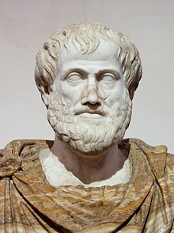
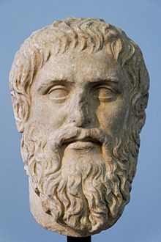
Greek Philosophy
After studying and observing existing governments, Aristotle found three forms of government that would rationally direct human affairs: monarchy, aristocracy, and constitutional government. Aristotle preferred the latter.

Slide 25
Legacy of Greece
In Aristotle’s Politics, he stated, “Man is by nature a political animal; it is his nature to live in a state.”
Legacy of Greece- set lasting standards in politics and philosophy. They did not rely on superstition or traditional explanations of the world.
They used reason and intelligence to discover predictable patterns that they called natural laws.
They did not want to be subject to totalitarian rulers. So they developed direct democracy in order that citizens could actively participate in political decisions.
They were also the first to think of three branches of government- a legislative branch to pass laws, an executive to carry out the laws, and a judicial branch to settle disputes about the laws.

Slide 26
Rise of Democratic Ideas Quiz
10. What was a major consequence of the Peloponnesian War?
11. What was so unique about Greek philosophy?
12. What is the Socratic Method?
13. Do you agree or disagree with this statement from Plato: Plato believed that people could not achieve a good life unless they lived in a just and rational state. Explain your reasons.
14. Briefly describe the lasting legacy of Greece?

Slide 27
The End.

Slide 28
The Trial of Socrates
Can a democracy exist without freedom of thought and expression?
Should free speech be permitted if it threatens the existence of democratic institutions?

