Slide 1
The Rise of democratic ideas rome

Slide 2
Rome Develops a Republic
From 1000 to 500 BC the earliest Romans battled Greeks and Etruscans for control of the Italian peninsula
Beginning in 600 BC a series of kings ruled Rome
In 509 BC Roman aristocrats overthrew the king and established a republic
A republic is a form of government in which power rests with citizens who have the right to elect the leaders who make government decisions

Slide 3
1. What is a republic?

Slide 4
In Rome, as in Greece, citizenship with voting rights was only granted to free-born males
Early class struggle in Rome- between the plebeians- common farmers, artisans, and merchants and the
Patricians who were aristocratic landowners (who held most of the power)
Romans established a government with separate branches
Colosseum | Art History: - 400 C.E. Ancient Cultures | Khan Academy

Slide 5
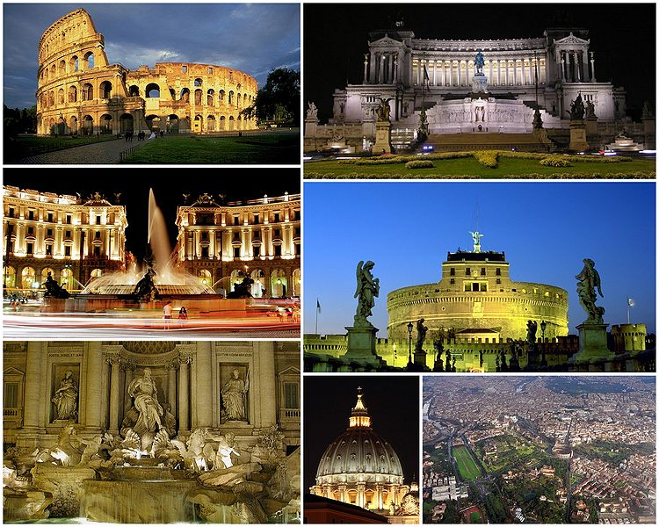

Slide 6
Two officials called consuls commanded the army and directed the government
Legislative was the Senate (controlled foreign and financial policies) and two assemblies
Empire continued to expand- for decades Rome altered between chaos and civil war
In 27 BC the republic collapsed and Augustus became emperor

Slide 7
2. What happened in 27 B.C. when the republic collapsed?

Slide 8
Roman Law
The Romans tried to create a code of laws that would be universal throughout the empire
Important principles of Roman Law:
1. All citizens had the right to equal treatment under the law
2. A person was considered innocent until proven guilty
3. The burden of proof rested with the accuser rather than the accused
4. Any law that seemed unreasonable or grossly unfair could be set aside

Slide 9
3. Name one important principle of Roman Law.

Slide 10
Written Legal Code
451 BC a collection of Roman Laws called the Twelve Tables was put together
The Tables assumed that all citizens had a right to the protection of the law
1000 years later in AD 528, Emperor Justinian ordered the compiling of all Roman laws since the earlier code.
The Code of Justinian later became a guide on legal matters throughout western Europe.

Slide 11
4. One of the first law codes, the 12 Tables, was put together by the Romans- what did it do for the citizens of Rome?

Slide 12
Written laws helped establish the idea of “a government of laws, not of men,” where even rulers and other powerful persons could sometimes be held accountable for their actions

Slide 13
Legacy of Rome
Rome gave the world the idea of a republic
Legal and political terms, common today, originated in Rome (senate, dictator).
Rome adopted from the Greeks the notion that an individual is a citizen in a state rather than the subject of a ruler.
Greatest legacy- was its written legal code and the idea that this code should be applied equally and impartially to all citizens

Slide 14
5. What was Rome’s greatest legacy?

Slide 15
Rome preserved and added to Greece’s idea of democracy and passed on the early democratic tradition to civilizations that followed.

